Slide 1



Project
Tento
A free online evaluation platform for Cambridge students

Slide 2



Our Team
Nafisa Maliyat
Kazi Jawadul Islam Jishan
Shanta Maria
200042133
200042165
200042172

Slide 3


Table of Contents
01
Project
Overview
02
Motivation
03
Benefits
04
05
06
Key
Features
Technology
Challenges
07
08
Future Goals
Timeline

Slide 4
01
Project Overview

Slide 5
Online Educational Website
Free to use
Targeted audience: O and A level candidates
Evaluation using MCQs
Topics from the entire Cambridge syllabus
Vast range of subjects

Slide 6
02
Motivation

Slide 7
What Motivated Us?
Lack of online exam platforms for English Medium Students
Thousands of taka wasted on mock exams
Time wasted while going to different coaching centres

Slide 8
03
Benefits

Slide 9


How will it be beneficial?
1
2
3
4
No paying for extra mock exams
No buying solution books
No time wasted going to coaching centres
Free practice materials!

Slide 10
04
Key Features

Slide 11
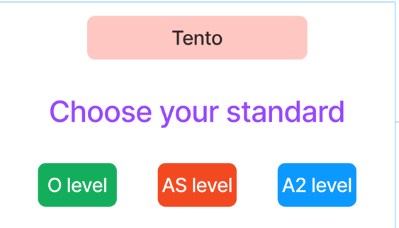

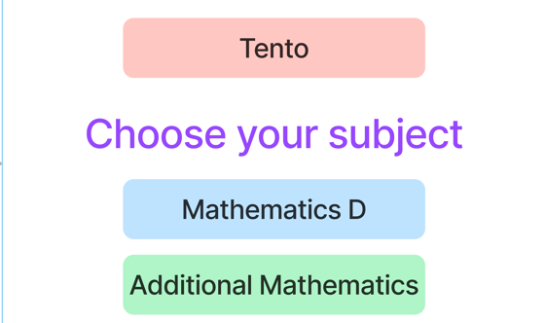
01
Buttons for choosing class
02
Buttons for choosing subject

Slide 12
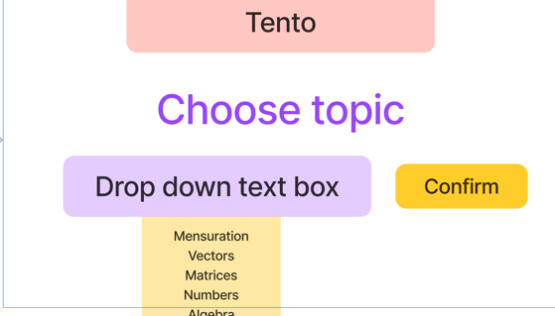

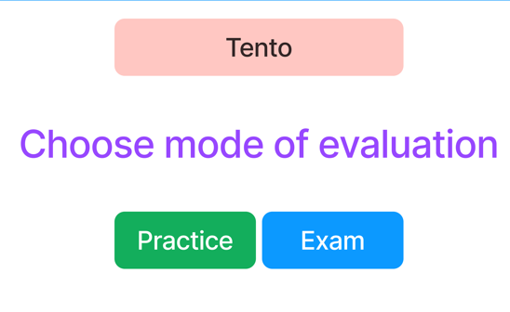
03
Drop down options for choosing topic
04
Buttons for choosing mode

Slide 13
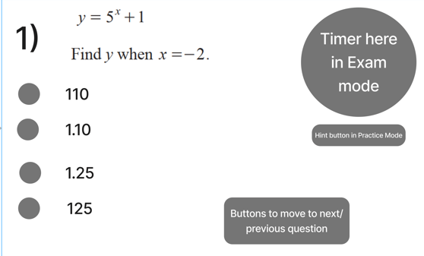
08
Display Mode (Light/Dark) Button
05
Timer Displayed
here
06
MCQ Options as Radio buttons
Hint Button
07

Slide 14

12
Detailed Solution on another screen after evaluation
09
Random Motivational Quote
Score based on correct answers
11
10
Download button for PDF of the solutions

Slide 15
05
Technology

Slide 16



Technologies Used
Front End
Database
Back End
HTML, CSS, JavaScript
MySQL
PHP

Slide 17
06
Challenges

Slide 18



Challenges
01
Features
Hard to implement
02
Deadline
Hard to meet because of tight schedule
03
Technology
Working with new technology
04
Teamwork
Working as a team

Slide 19
07
Future Goals

Slide 20


Addition
Advancement
Future
Goals
Update
Expansion
Addition of more subject from Cambridge curriculum
Option to evaluate written answers from users
Topics in website updated as syllabus updates
Expanding the syllabus to include more curriculums

Slide 21
08
Timeline

Slide 22
Timeline Infographics
Week 1-2
Brainstorming
Idea
Week 3-4
Planning and Background Learning
Week 5-7
Front End Development
Week 8-10
Database Management
Week 11-13
Back End Development
Week 14
Testing

Slide 23
Thank you for listening. Any suggestions would be welcomed

